Slide 1
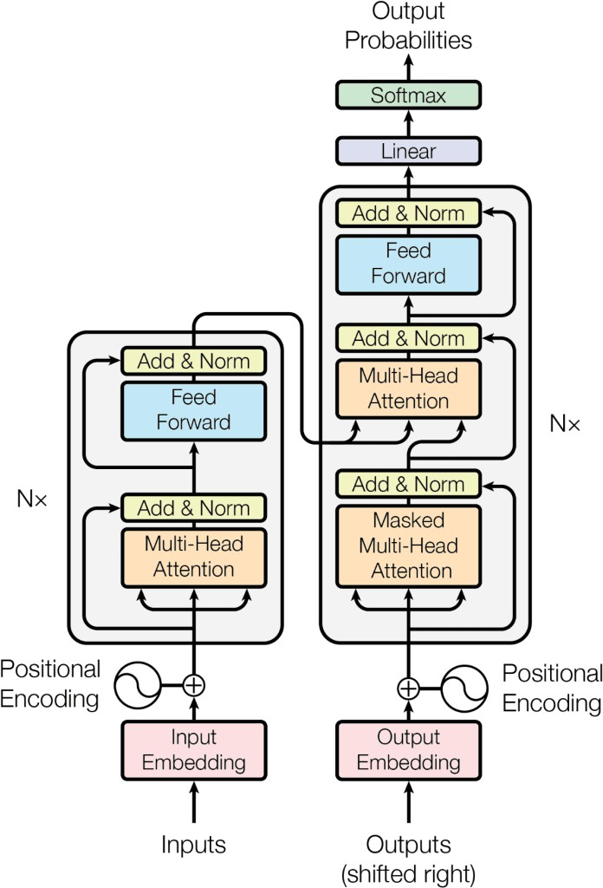
Transformer from scratch
https://github.com/hkproj/transformer-from-scratch-notes

Slide 2
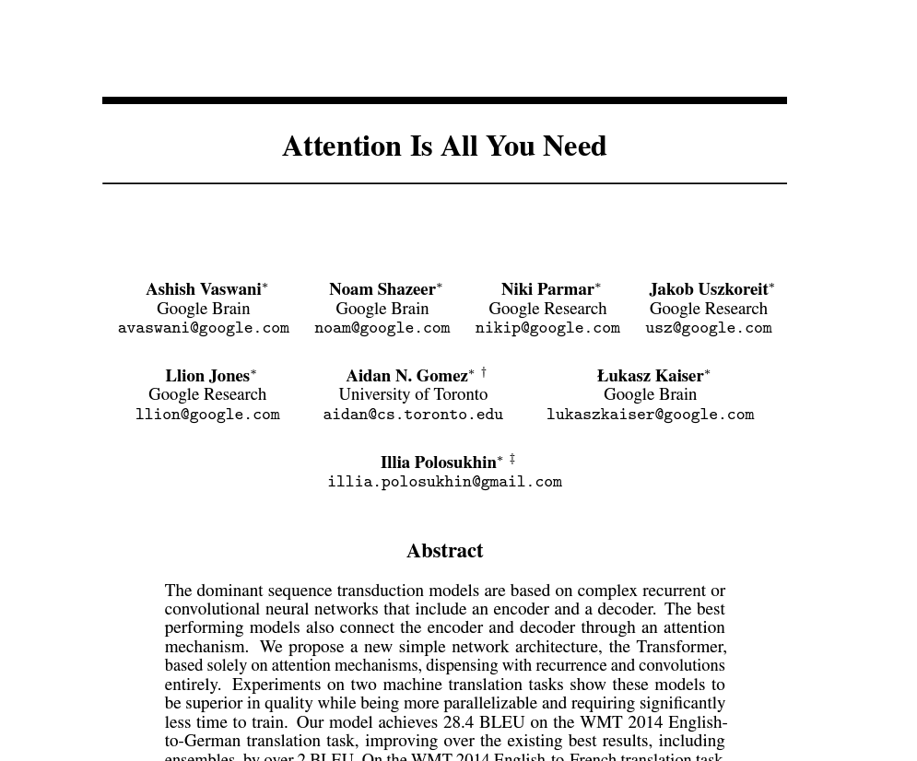
https://papers.neurips.cc/paper/7181-attention-is-all-you-need.pdf

Slide 3
Recurrent Neural Networks (RNN)
Y1
Y2
Y3
YN
State
<0>
RNN
RNN
RNN
…
RNN
X1
X2
X3
XN
Time Step 1
Time Step 2
Time Step 3
Time Step N

Slide 4
Problems with RNN (among others)
Slow computation for long sequences
Vanishing or exploding gradients
Difficulty in accessing information from long time ago

Slide 5
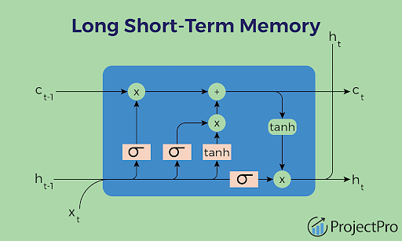
LSTM

Slide 6
Problems with LSTM (among others)
Training complexity: LSTMs are more complex than traditional RNNs, which can make them more difficult to train. This complexity can also make it harder to interpret and debug an LSTM network.
Overfitting: LSTMs are prone to overfitting, especially when working with small datasets. This can lead to poor performance on new, unseen data.
Computational cost: LSTMs require more computational resources than traditional RNNs, which can make them slower and more expensive to train.
Lack of transparency: Like other deep learning models, LSTMs can be difficult to interpret and explain. This can make it harder to understand how the model arrived at its predictions, which can be a concern in some applications.

Slide 7
Introducing the Transformer
The Transformer is foundational to the recent advancements in large language models (LLMs). In this lecture, we will attempt to unravel some of its inner workings and hopefully gain some insight into how these models function.

Slide 8
What is a Transformer?
The Transformer is a deep learning model for sequence modeling. Given a sequence of things, the model can predict what the next thing in the sequence might be. In this lecture, we will look at word sequence prediction, but you can apply Transformers to any kind of sequential data.
As an example, take the following phrase that we would like to complete (a.k.a. the “prompt”):
“The robots will bring _________”
Conceptually, we might think of the Transformer as a function that operates on this phrase as input:

Slide 9


Slide 10
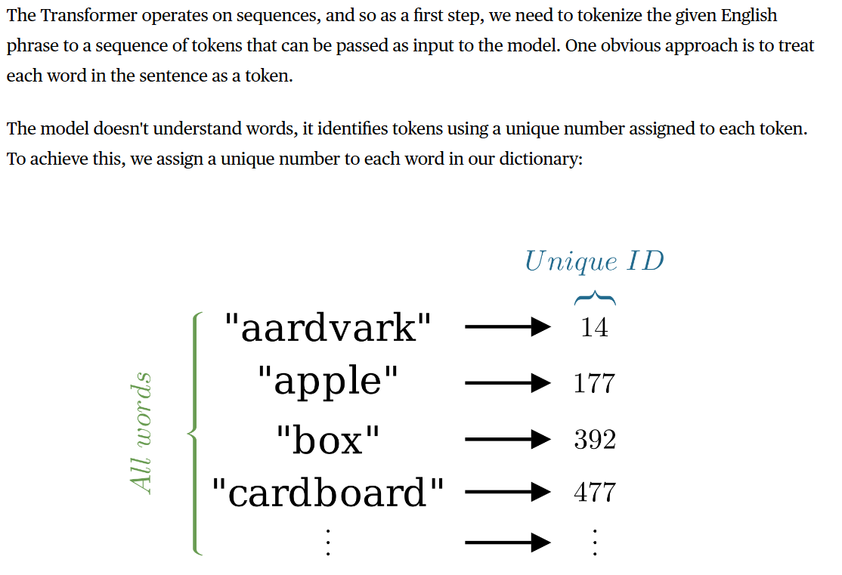

Tokenization

Slide 11
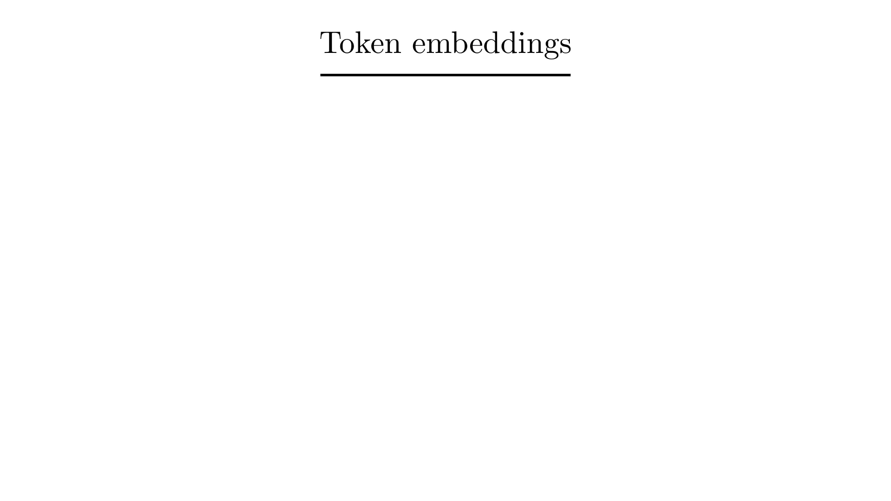
Embeddings
For each token, the Transformer maintains a vector called an “embedding”. An embedding aims to capture the semantic meaning of the token - similar tokens have similar embeddings.
The input tokens are mapped to their corresponding embeddings:
Our transformer has embedding vectors of length 768. All the embeddings can be packed together in a single T × C matrix, where T = 4 is the number of input tokens, and C = 768, the size of each embedding.

Slide 12
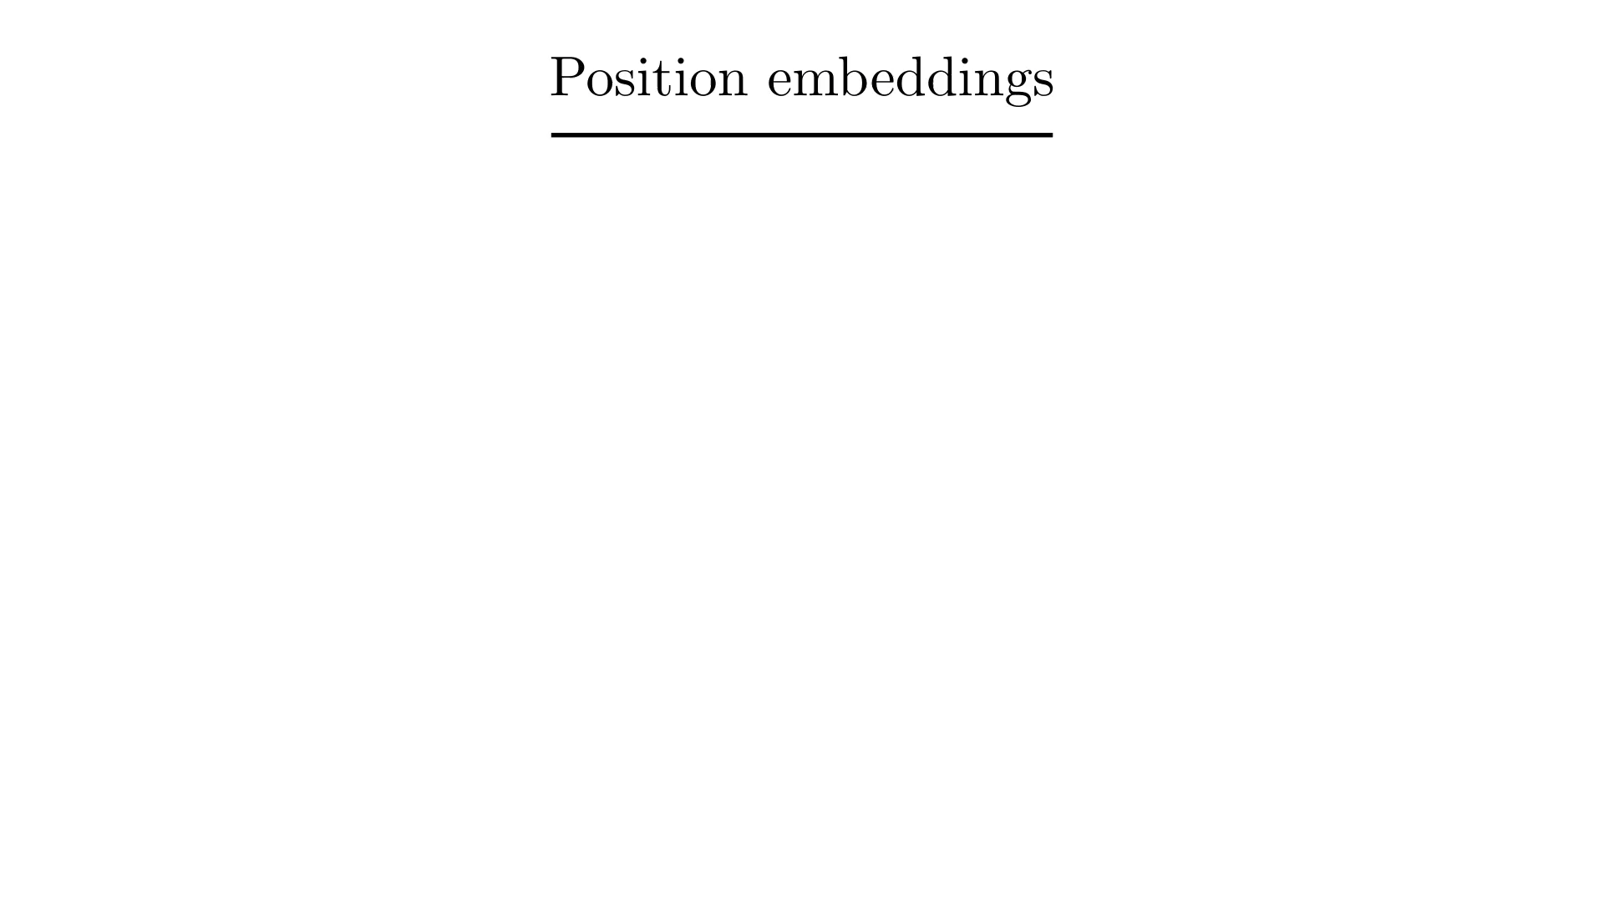
Position embedding
In order to capture the significance of the position of a token within a sequence, the Transformer also maintains embeddings for each position. Here, we fetch embeddings for positions 0 to 3, since we only have 4 tokens:

Slide 13
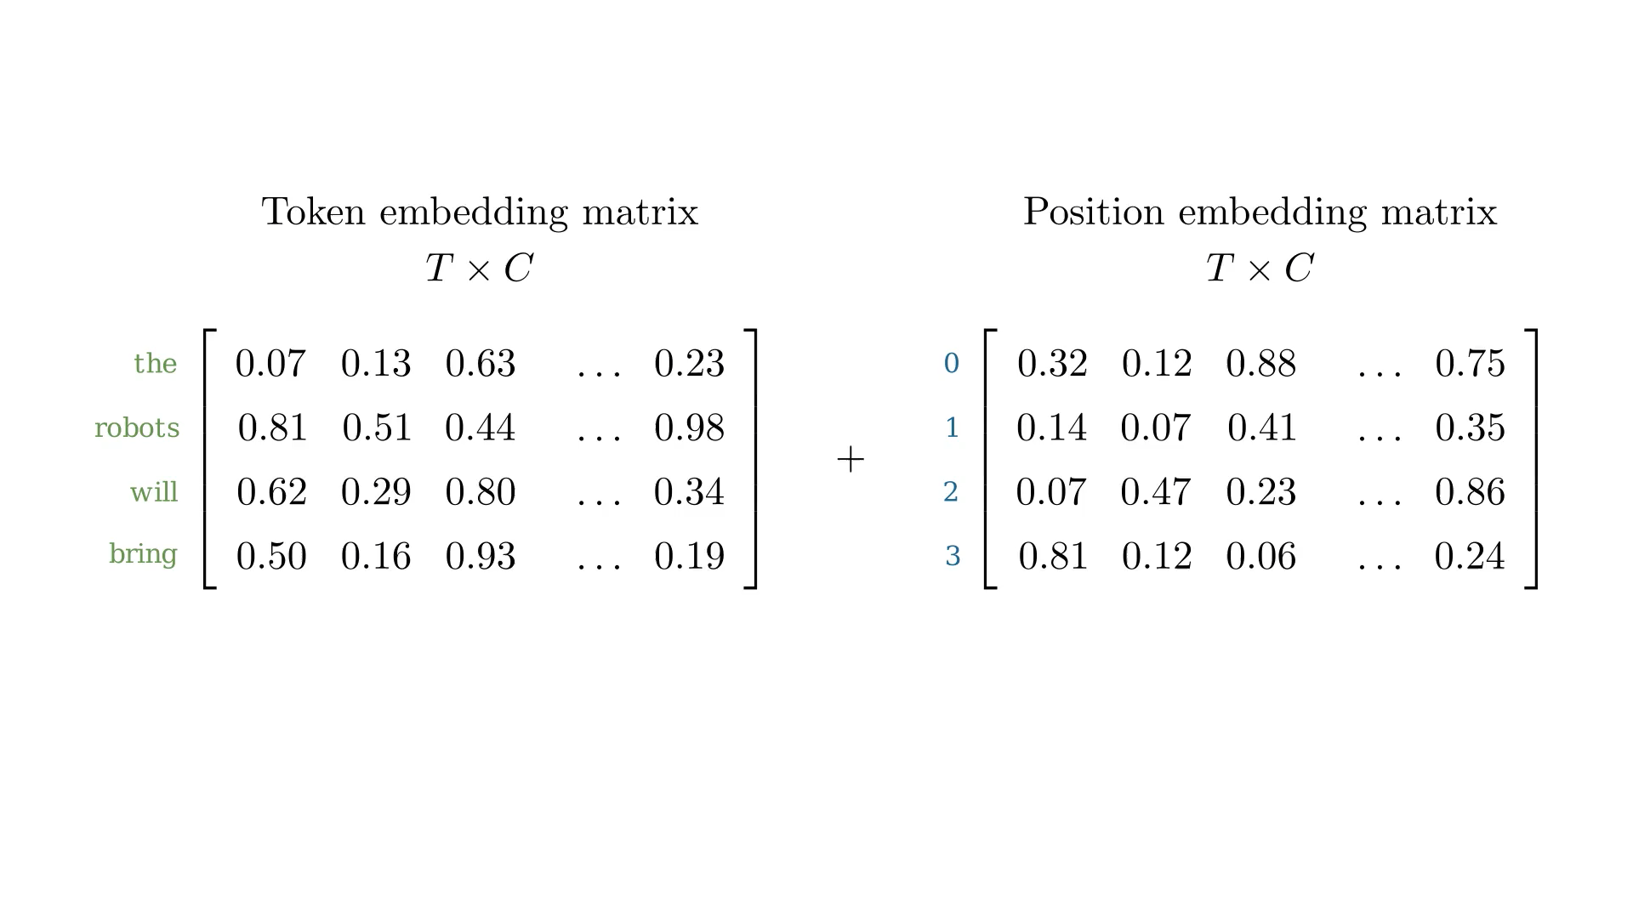
Position embedding
Finally, these two T × C matrices are added together to obtain a position-dependent embedding for each token:
The token and position embeddings are all part of θ, the model parameters, which means they are tuned during model training.

Slide 14
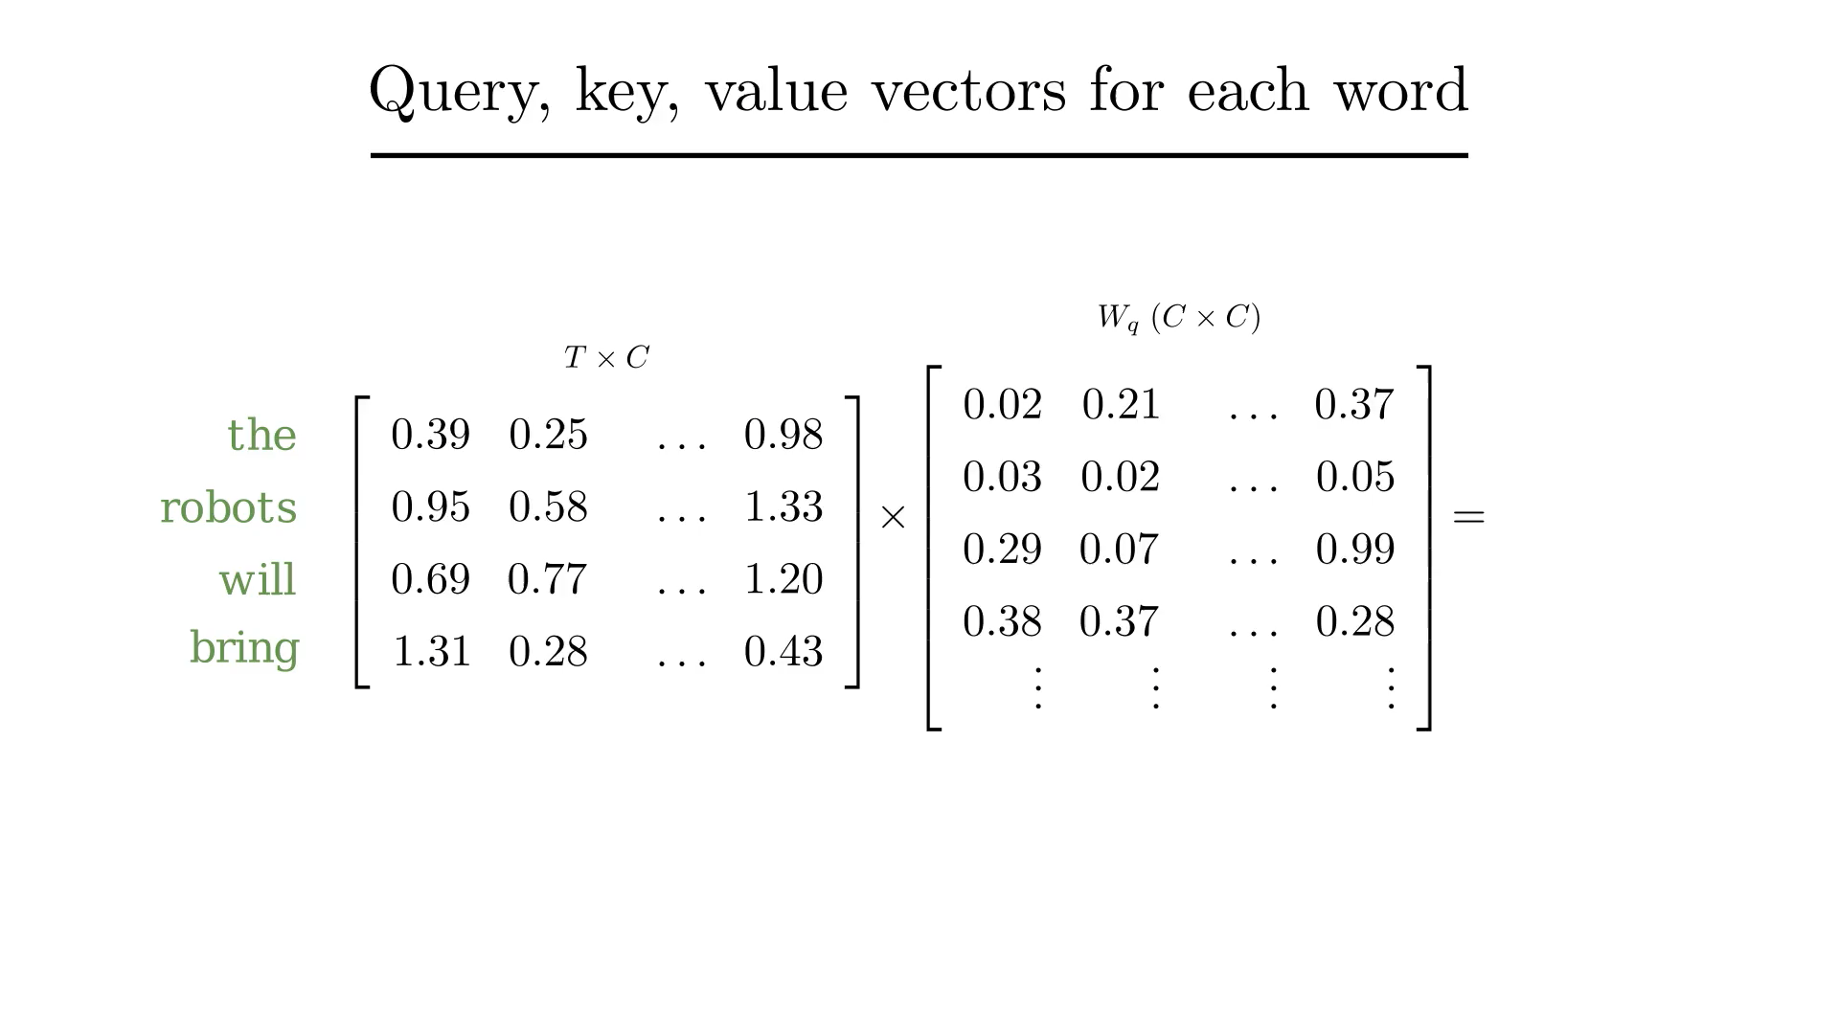
Queries, keys and values
The Transformer then computes three vectors for each of the T vectors (each of row in the T × C matrix from the previous section): “query”, “key” and “value” vectors. This is done by way of three linear transformations (i.e., multiplying with a weight matrix):
The weight matrices that produce Q, K, V matrices are all part of θ.
The query, key and value vectors for each token are packed together into T × C matrices, just like the input embedding matrix. These vectors are the primary participants involved in the main event which is coming up shortly: self-attention.

Slide 15
Queries, keys and values
But what are these queries, keys and values? One way to think about these vectors is using the following analogy:
Imagine you have a database of images with their text descriptions, and you would like to build an image search engine. Users will search by providing some text (the query), which will be matched against the text descriptions in your database (the key), and the final result is the image itself (the value). Only those images (values) whose corresponding text description (key) best matches the user input (query) will be returned in the search results.
Self-attention works in a similar manner - the tokens in the user input are trying to “query” other tokens to find the ones they should be paying attention to.

Slide 16
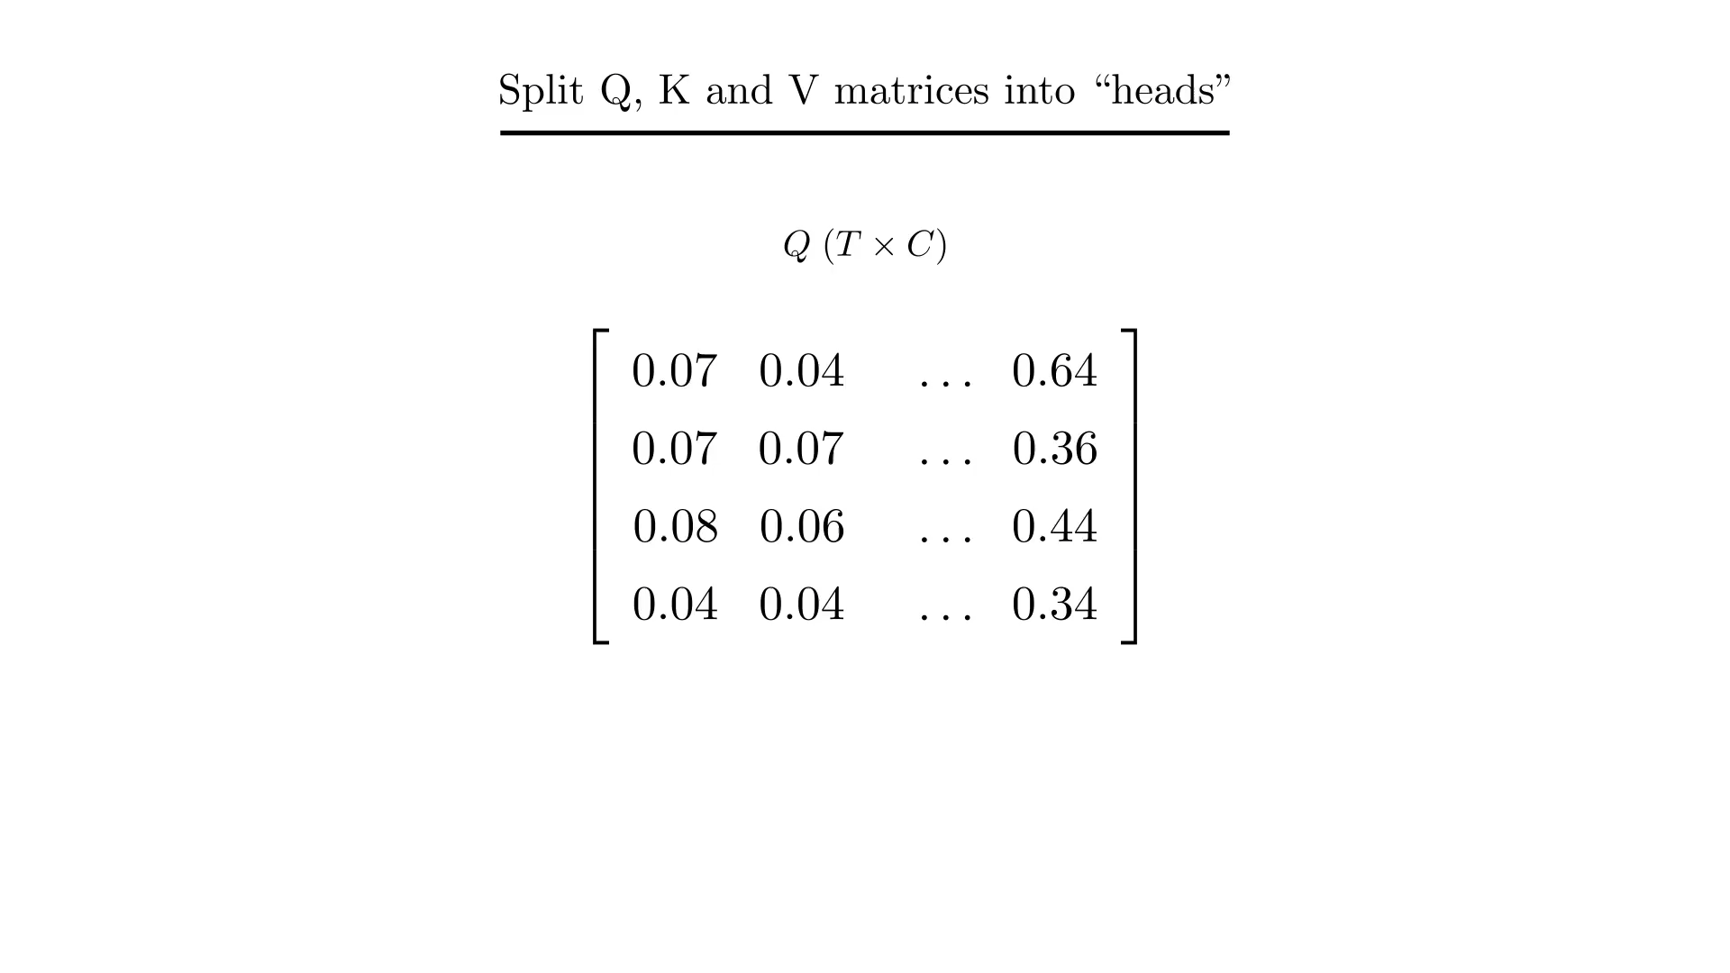
Two heads are better than one
To recap: so far, starting from our input T × C matrix containing the token + position embeddings, we have computed three T × C matrices: (1) the Query matrix Q, (2) the Key matrix K, and (3) the Value matrix V.
The Transformer then splits these matrices into multiple so-called “heads”:
Here, we see the Q matrix being split length-wise into twelve (T × H) heads. Since Q has 768 columns, each head has 64 columns.
Self-attention operates independently within each head, and it does so in parallel. In other words, the first head of the Query matrix only interacts with the first heads of the Key and Value matrices. There is no interaction between different heads.
The idea behind splitting into multiple heads is to afford greater freedom to the Transformer to capture different characteristics of the input embeddings. E.g., the first head might specialize in capturing the part-of-speech relationships, and another might focus on semantic meaning, etc.

Slide 17
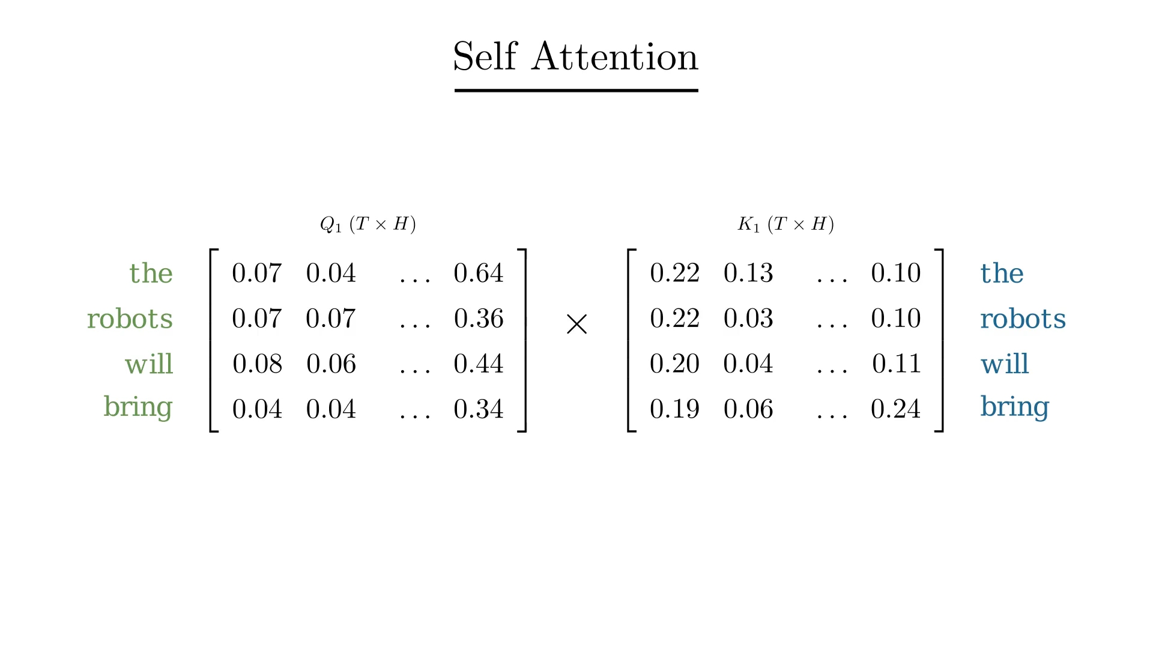
Time to pay attention
Self-attention, as we've mentioned earlier, is the core idea behind the Transformer model.
We first compute an “attention scores” matrix by multiplying the query and key matrices (note that we are only looking at the first head here, but the same operation occurs for all heads):
This matrix tells us how much attention, or weightage, a particular token needs to pay to every other token in the sequence for producing its output, i.e., prediction for the next token. E.g., the token "bring" has an attention score of 0.3 for the token "robot" (row 4, column 2 in matrix A1).

Slide 18
Applying attention
The attention score for a token needs to be masked if it occurs earlier in the sequence for a given target token. E.g., in our input phrase: “the robots will bring _____” it makes sense for the token “bring” to pay attention to the token “robots”, but not vice-versa, because a token should not be allowed to look to the future tokens for making a prediction of its next token.
So we hide the upper-right triangle of the square matrix A1, effectively setting the attention score to 0.
We then bring the third actor onto the stage, the Value matrix V:

Slide 19
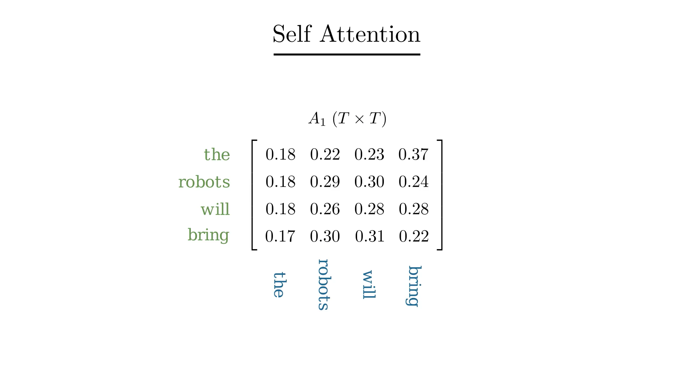
Applying attention
The output for the token “robots” is a weighted sum of the Value vectors for the previous token “the” and itself. Specifically, in this case, it applies a 47% weight to the former, and 53% weight to its own Value vector (work out the matrix multiplication between A1(T × T) and V1(T × H) to convince yourself that this is true). The outputs for all other tokens is computed similarly.

Slide 20
Putting all heads together
The final output for each head of self-attention is a matrix Y of dimensions T × H (T = 4, H = 64).
Having computed the output embeddings for all tokens across all 12 heads, we now combine the individual
T × H into a single matrix of dimension T × C, by simply stacking them side-by-side:
64 embedding dims per head (H)× 12 heads = 768, the original size of our input embeddings (C).

Slide 21
Making a prediction
Finally, we are ready to make a prediction:
The last output of the last block in the Transformer will give us a C length vector for each of our input tokens. Since we only care about what comes after the last token, “bring”, we look at its vector. A linear transform on this vector - multiplying with another weight matrix of dimensions V × C, where V is the total number of words in our dictionary - will give us a vector of length V.
This vector when normalized gives us a probability distribution over every word in our dictionary, which allows us to the pick the one with the highest probability as the next token.
In this case, our Transformer has assigned a probability of 92% on “prosperity” being the next token, while there's only a 10% chance of “destruction”, so our completed sentence now reads: “the robots will bring prosperity”. I suppose we can now rest easy with the knowledge that AI's imminent takeover of human civilization promises a future of prosperity and well-being, rather than death and destruction.

Slide 22
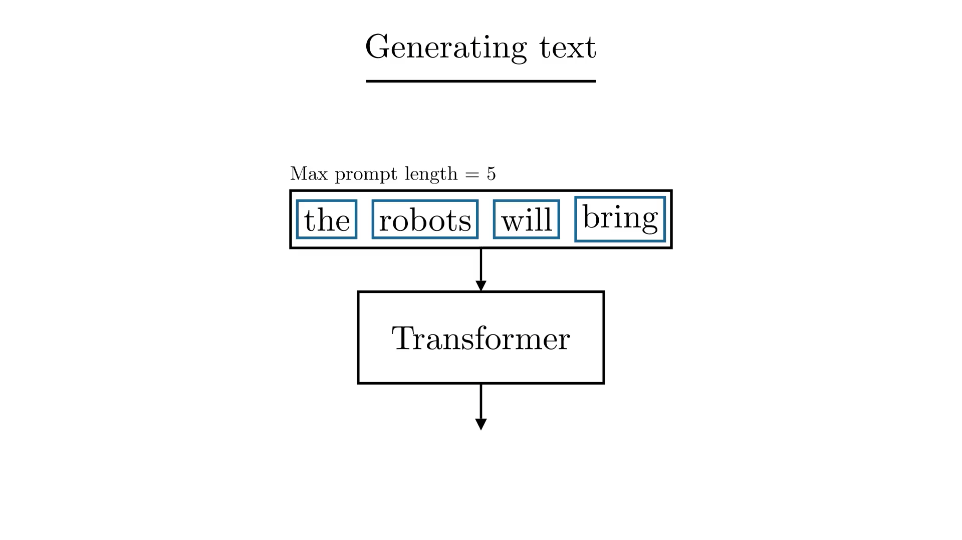
Generating….
Now that we can predict the next token, we can generate text, one token at a time:

